Slide 1

FUNDAMENTAL MECHANISMS IN MACHINE LEARNING
Start
Lyernisha S R
Lecturer, FICT

Slide 2
objectives
WHAT IS ML?
HOW IT WORKS?
types
application

Slide 3
Traditional programming
What is ML?
MACHINE LEARNING
Data
Data
Machine
Results
Machine
Program
Program
Results
Machine learns from past experience and data
Task that can be defined only by example
No need for constant redesign

Slide 4



WORKING PRINCIPLE
Training
data
Machine learning
algorithm
Model
Predicted
Result
New data
MORE DATA > BETTER MODEL > HIGHER ACCURACY

Slide 5
Types of machine learning
Supervised Learning
Unsupervised Learning
Reinforcement Learning

Slide 6



Supervised learning
Requires input-output pairs
Uses labeled data for identification
Classification and regression
Feature
+
Label
Algorithm
Model
Apple
color
Feature - color and shape
Label – Apple, Mango
shape

Slide 7
Unsupervised learning
Algorithm
Model
Apple
Requires only input
Self Learning
Clustering and association

Slide 8
Reinforcement Learning
Teach a machine when it makes mistake
Rewards and errors
TRIAL and WIN
Feedback
Model
Mango
Response
Time

Slide 9
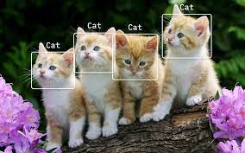
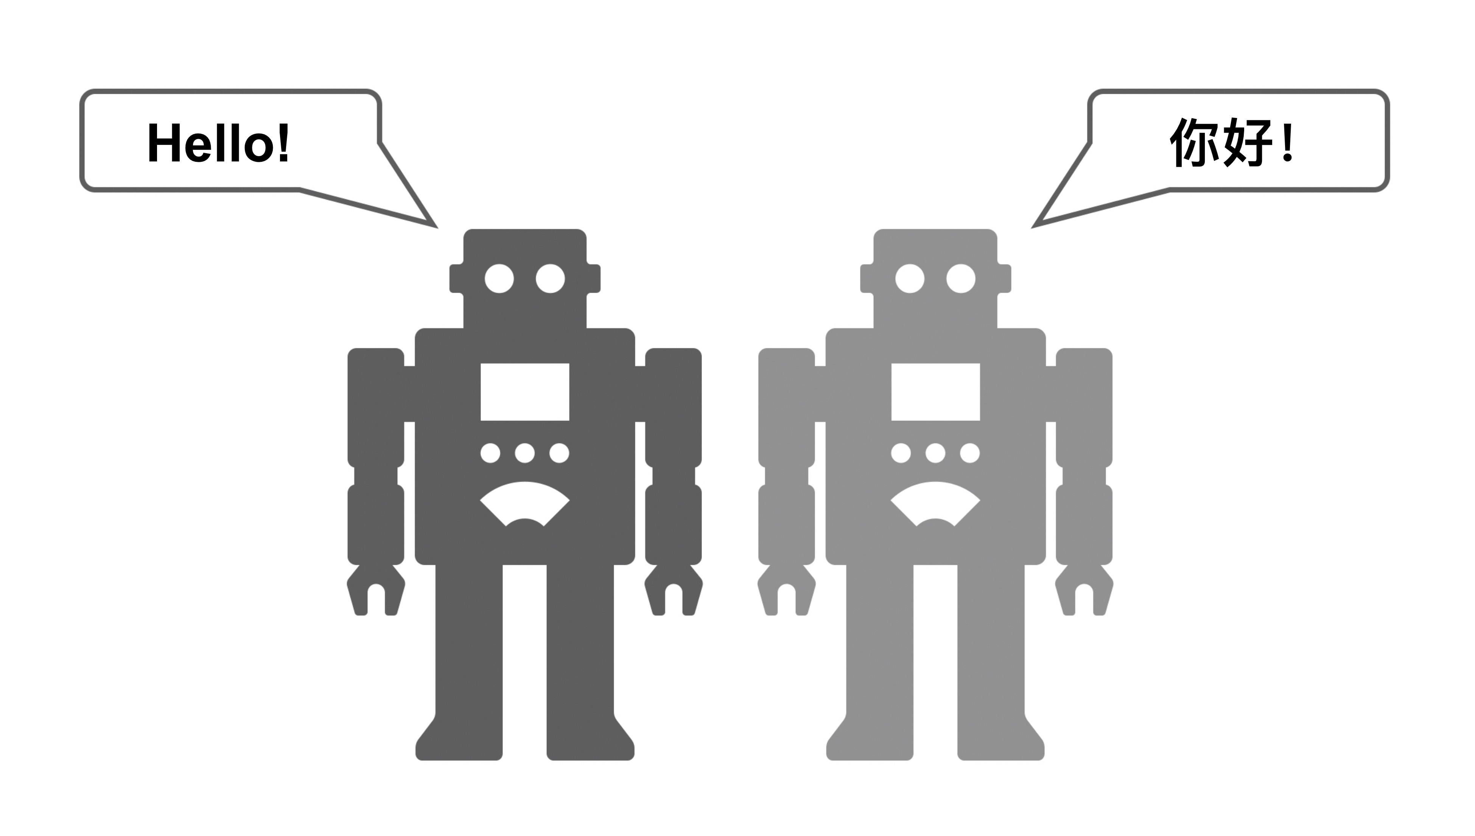

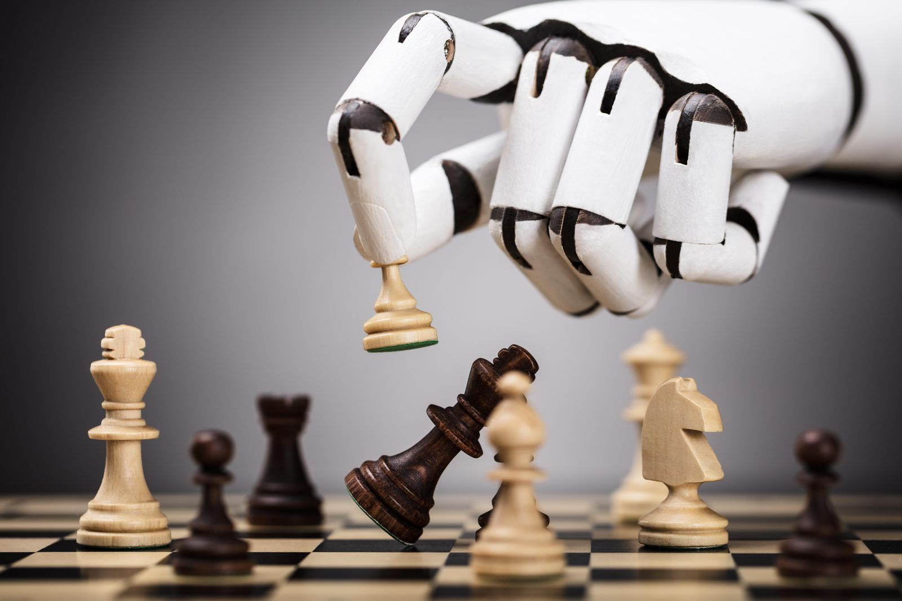
Applications
Object recognition
Machine translation
Recommendation system
Game playing

Slide 10
Summary
ML is to make machine learn form the past experience(training) and data
Helps with the task which programmers can’t describe
Uses three types of learning mechanism
ML techniques use a train + test system (cross validation) before using findings in real situations
Thank you!

